Slide 1
BOOKING INsights
DataGemini Analytics
"Insightful Analytics, Reliable Results”
Notes:
https://www.kaggle.com/datasets/jessemostipak/hotel-booking-demand

Slide 2
Setting Up The Stage:
Company
Consultancy - Data Analytics Company
Client
Hotel Chain – Multiple Properties
Specs
Booking Trends & Customer Preferences

Slide 3

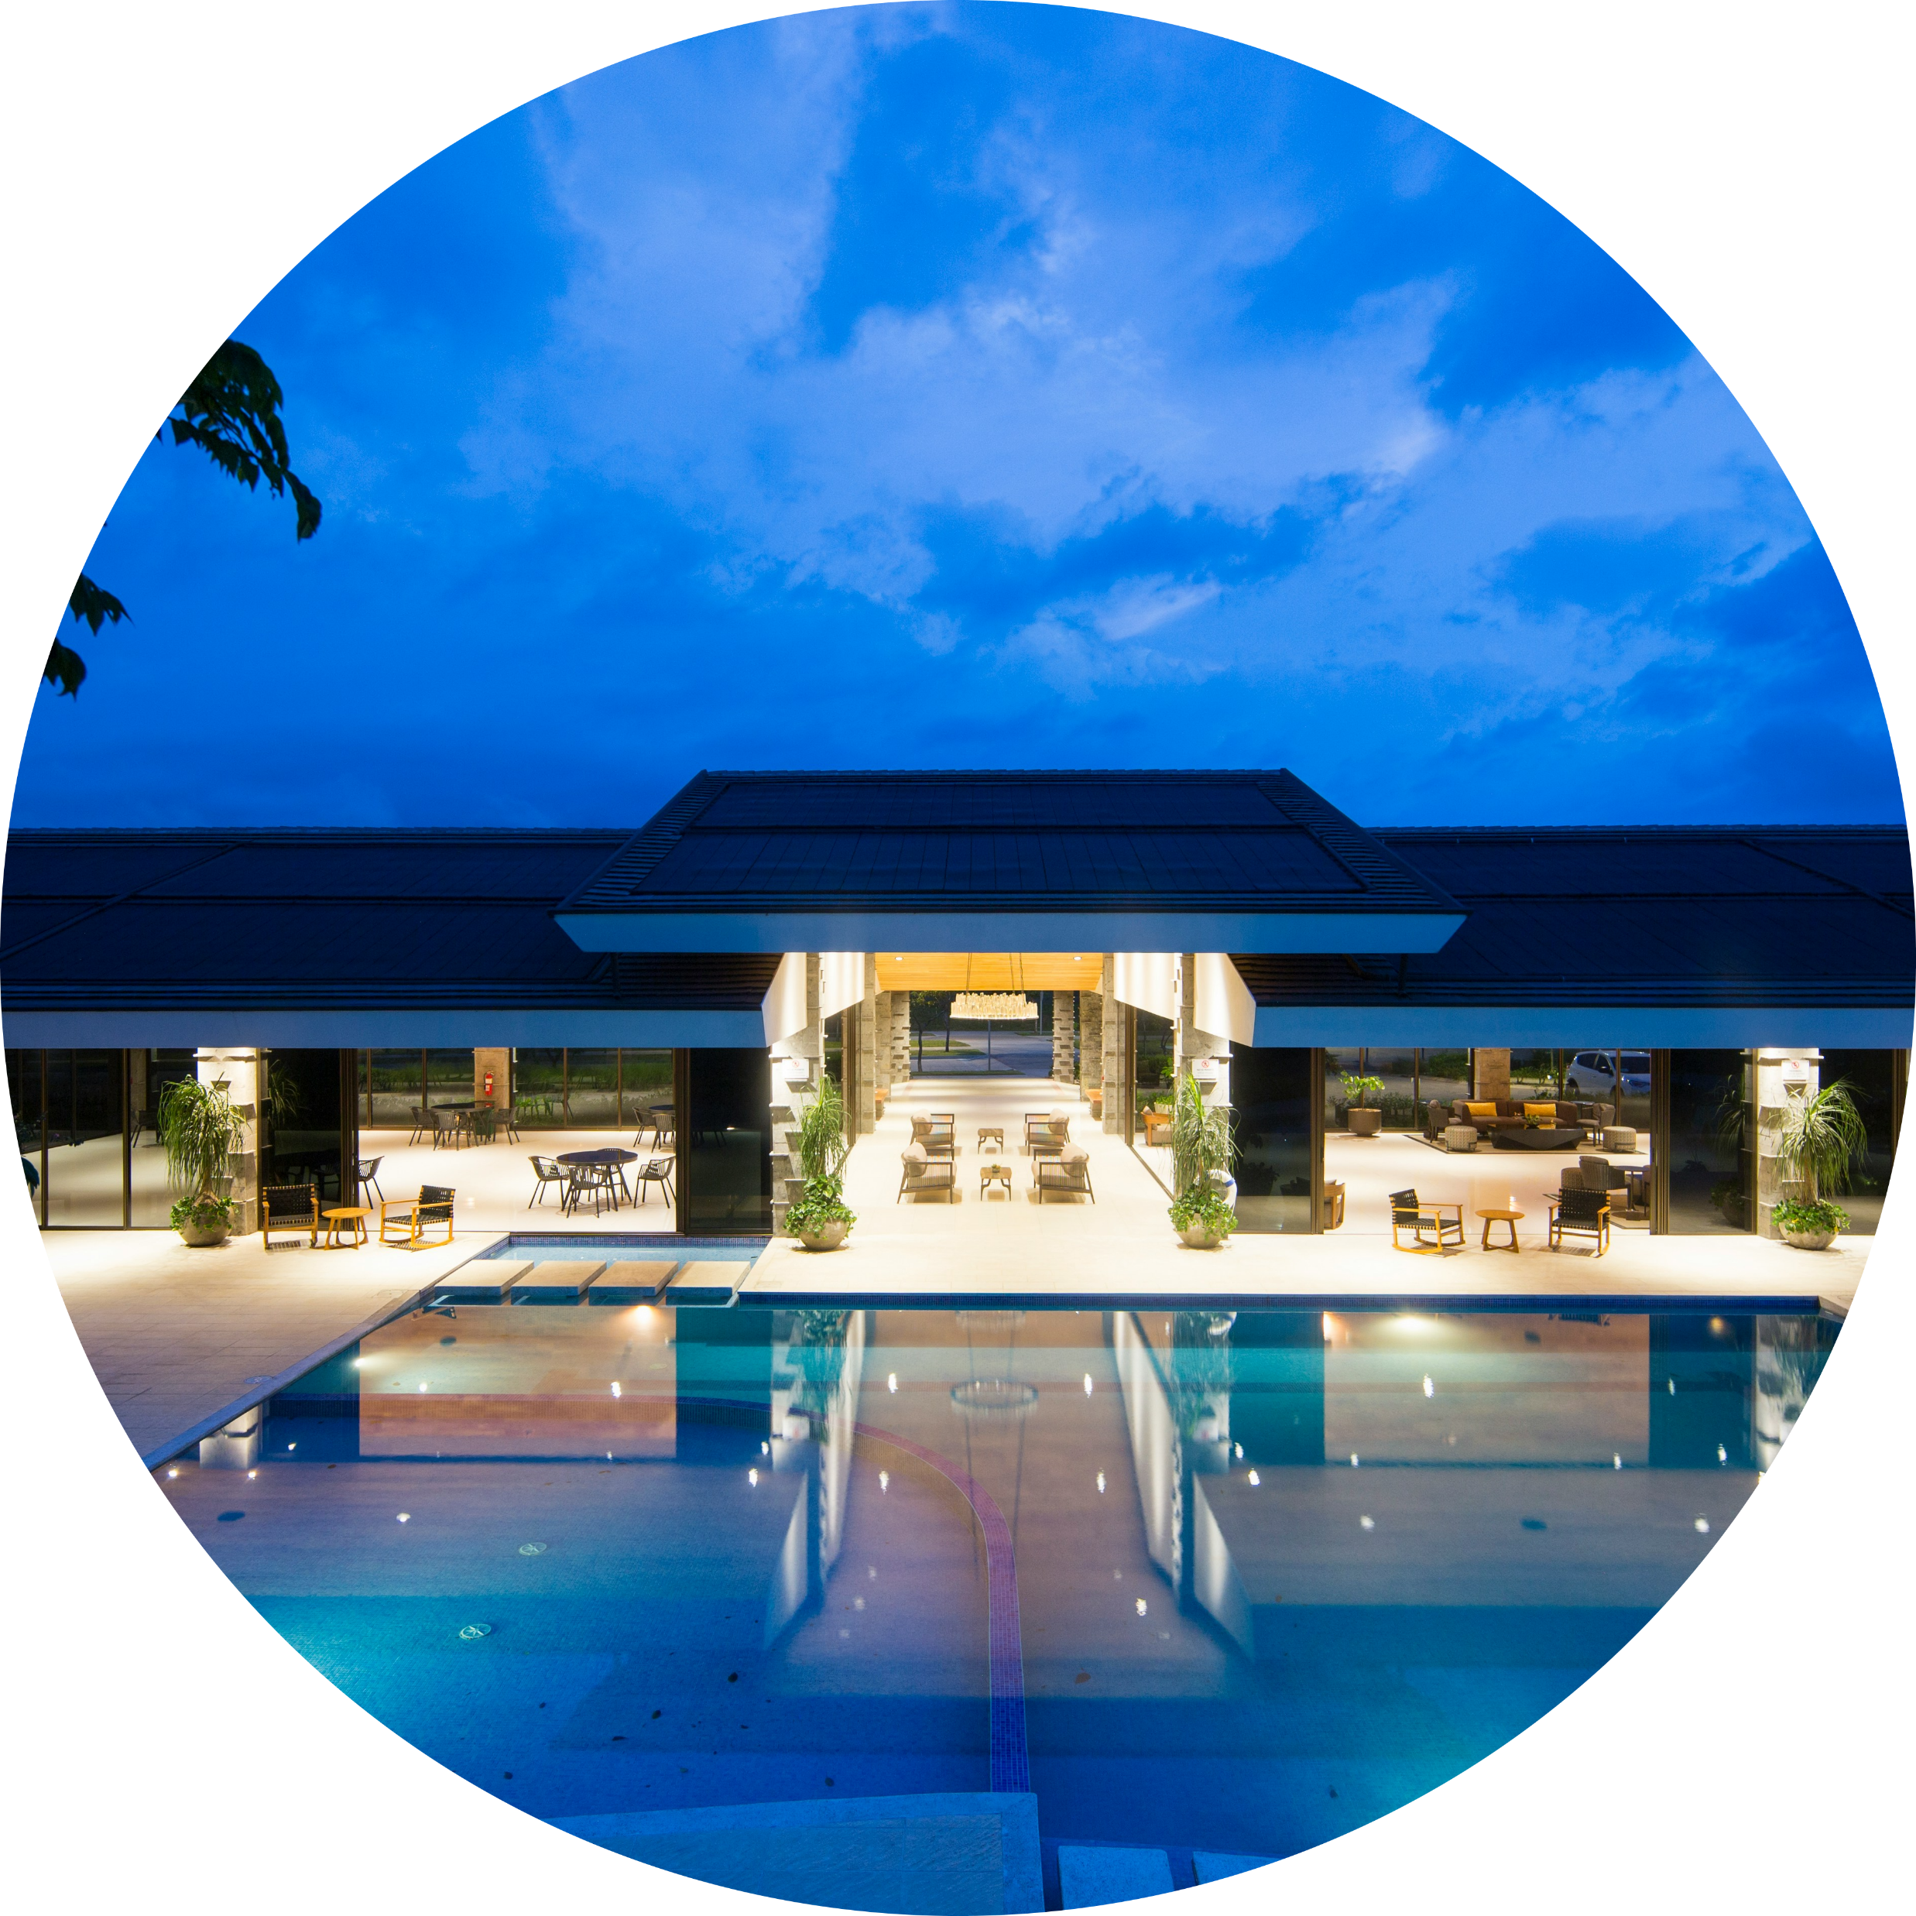

HOSPITALITY in the FOCUS - IDEATION
WHO
WHAT
HOW
GUESTS
EXPECTATIONS
SATISFACTION
Notes:
Images:
- Foto von Fernando Álvarez Rodríguez auf Unsplash >> https://unsplash.com/de/s/fotos/Luxushotelzimmer
- Foto von Timon Studler auf Unsplash >> https://unsplash.com/de/s/fotos/
- Foto von Mantas Hesthaven auf Unsplash >> https://unsplash.com/de/s/fotos/Koffer-Tourist

Slide 4
HOSPITALITY through Insights - DATA
The Dataset (119K, 32 ) provides information about Hotel bookings:
Booking Dates
Types of Hotels
Customer Demographics
Booking Information (Room Type, Reservations, Cancellations)
Amenities (Meals, Parking Lots, Special Requests)

Slide 5
Business Case:
Different guest types have varying spending beahviours and preferences (e.g. influencing bookings and meal packages)
BC
Understanding these differences allows for tailored offerings and strategic pricing to optimize revenue and enhance guest satisfaction
ADR = Average Daily Rate

Slide 6
Hypothesis:
Different groups demonstrate a different willingness to spend on accomodations (refelected by the ADR).
HT
Different willingness to spend money by the groups reflects on varying preferences and requests.
ADR = Average Daily Rate

Slide 7
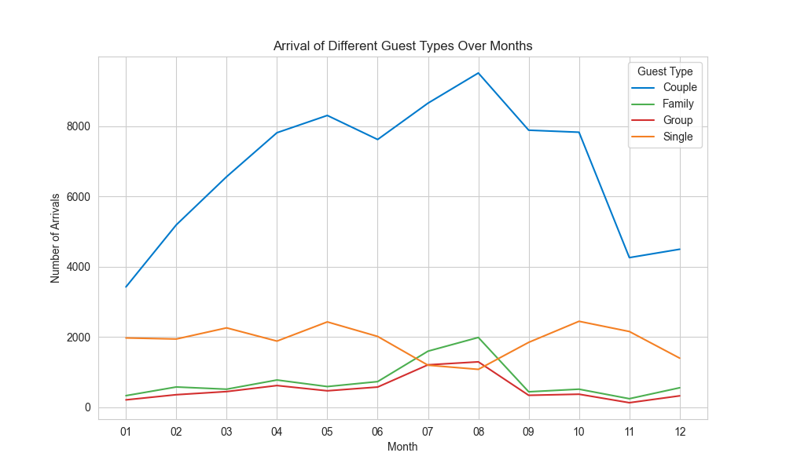




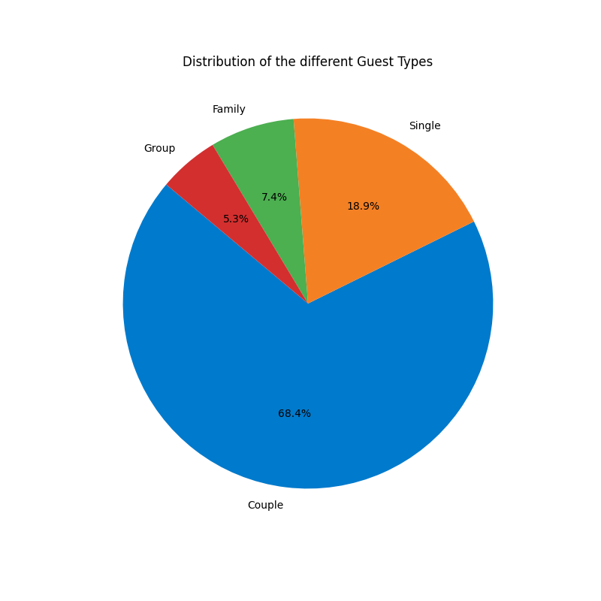



Different Guest Types Identifyed
4 Groups
3 Seasons
Couples
Singles
Families
Groups
Notes:
https://en.wikipedia.org/wiki/Average_daily_rate
<a href="https://www.flaticon.com/de/kostenlose-icons/geschlechtsneutral" title="geschlechtsneutral Icons">Geschlechtsneutral Icons erstellt von Freepik - Flaticon</a>
<a href="https://www.flaticon.com/de/kostenlose-icons/kinder" title="kinder Icons">Kinder Icons erstellt von edt.im - Flaticon</a>
a href=httpswww.flaticon.comdekostenlose-iconsfallen title=fallen IconsFallen Icons erstellt von Andy Horvath – Flaticona
<a href="https://www.flaticon.com/de/kostenlose-icons/fruhling" title="frühling Icons">Frühling Icons erstellt von SBTS2018 - Flaticon</a>
<a href="https://www.flaticon.com/de/kostenlose-icons/winter" title="winter Icons">Winter Icons erstellt von Freepik - Flaticon</a>

Slide 8
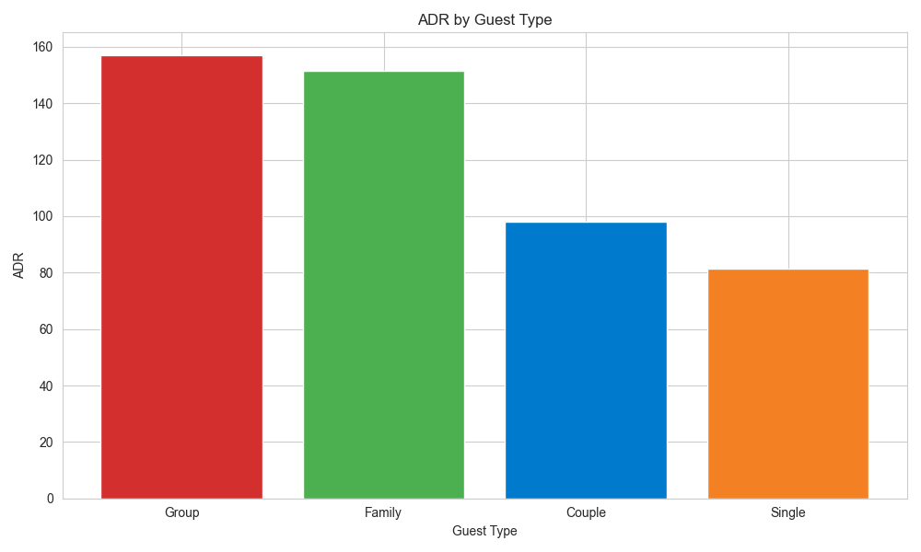

Average Daily Rate (ADR) By Guest
ADR – Recommendations:
Tailored Offerings for each guest type (group/family discount, special deals for couples and singles)
Enhance Amenities (e.g. spa treatments, kid-friendly activities)
Feedback Mechanism (Gather further analysis on preferences -> tailor offerings and available amenities)
ADR as defined by dividing the sum of all lodging transactions by the total number of staying nights
Notes:
https://en.wikipedia.org/wiki/Average_daily_rate
<a href="https://www.flaticon.com/de/kostenlose-icons/geschlechtsneutral" title="geschlechtsneutral Icons">Geschlechtsneutral Icons erstellt von Freepik - Flaticon</a>
<a href="https://www.flaticon.com/de/kostenlose-icons/kinder" title="kinder Icons">Kinder Icons erstellt von edt.im - Flaticon</a>

Slide 9
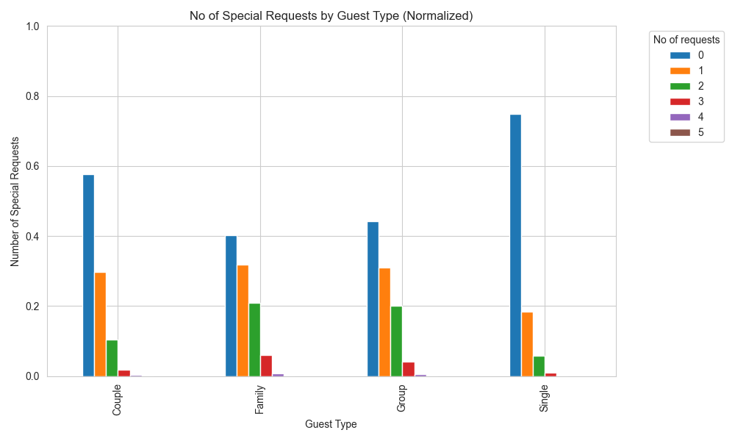

No of Special Requests By Guest
?
?
?
?
?
?
?
?
?
Meal Type Preferences – Recommendations
Personalized Recommendations (Targeted marketing and special offers for singles)
Ease of Booking: (Facilitate the ease of add special options)
Clear Information: (Include further investigations on why certain groups prefer certain meal types)

Slide 10
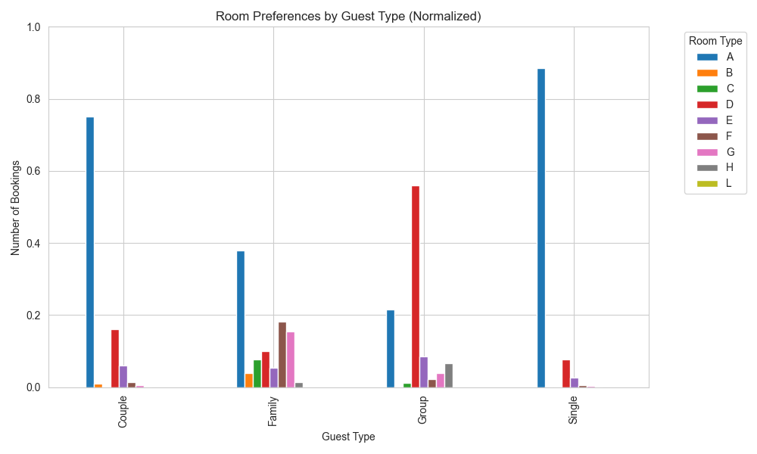
Room Preferences By Guest
Room
Type
Room
Variation
A
D
A
A
Room Type Preferences – Recommendations:
Flexibel Room Options (equip room with features suitable for target audience)
Group Accomodations (Special packages and accommodations for groups)
Solo Traveler Offerings (Special offerings tailored for solo travelers (e.g. budget friendly-single rooms))
Notes:
Room Type Preferences
- **Couples**:
- Room Type A is the most preferred among couples, with significantly higher number of bookings compared to other room types.
- Only few bookings for room types "H" and "L"
- **Families**:
- Room Type A is the most preferred among families, but not as striking. Followed by "F" and "G"
- There are als few bookings for room types "H" and "L"
- **Groups**:
- Room Type D is the most preferred among Groups, but not as striking. Followed by "A".
- The other room types are insignificant compared to the others
- **Singles**:
- Room Type A is the most preferred among Groups, with significantly higher number of bookings compared to other room types.
- Followed by "D". - The other room types are insignificant compared to the others
Room Type Preferences – Reommendations
- **Optimize Room Allocation**: Focus availability of preferred room types
- **Include Special Promotions**: Offer special promotions or discounts for less popular room types
- **Feedback**: Include further investigations on why certain groups prefer certain room types
###################################################################

Slide 11
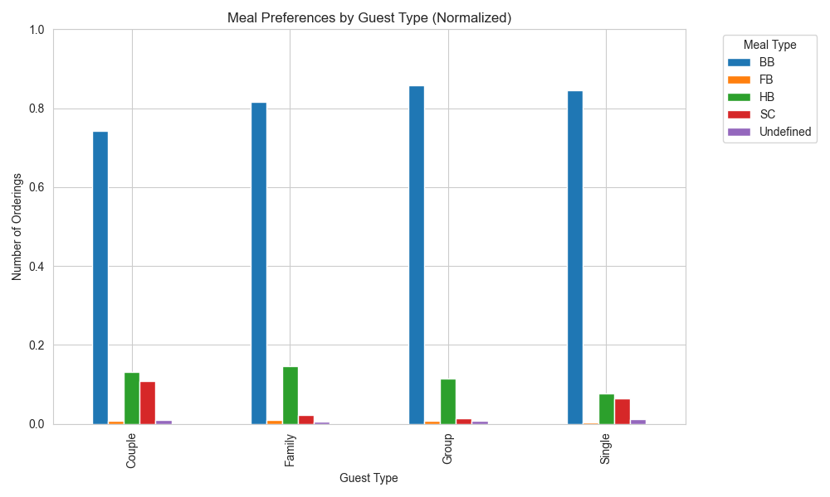

Meal choices By Guest
BB
- Bed and Breakfast (BB): Breakfast is included.
- Full Board (FB): Breakfast, lunch and evening meals are included.
- Half Board (HB): Breakfast and evening meals are included.
- Self Catering (SC): No meals are included.
- Room Only (O): No meals are included.
Meal Type Preferences – Recommendations
Customization: Allow for customized meal package options
Promote Meal Packages: Promote meal options such as HB or FB to increase revenue
Feedback: Include further investigations on why certain groups prefer certain meal types
Notes:
Meal Packages – Findings
- **Bed and Breakfast (BB)**:
- Popular among all guest types, with a significant number of bookings for couples and singles.
- A meal option included seems to be preffered as HB (half )
- **Half Board (HB) and Self-Catering (SC)**:
- Couples show a preference for these meal type, with a significant number of bookings
- Relatively insignificant for other guest types
- **Others**: - Other meal types are less interesing
Meal Type Preferences – Reommendations
- **Customization**: Customize meal options or allow for customization options for meal packages
- **Promote Meal Packages**: Promote meal packages such as HB or FB to increase revenue
- **Feedback**: Include further investigations on why certain groups prefer certain meal types

Slide 12
Conclusion
Identified Different Customer Groups
Cater the Differences
Confirmed Different Spending Budgets and Preferences
Tailored Offerings
Personalized Recommendations
Flexibel Room Options
Promote Meal Packages

